Slide 1
Op-Amp
ECE249

Slide 2
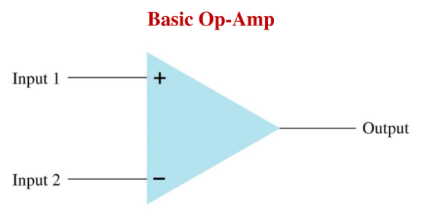
Op-Amp Symbol

Slide 3
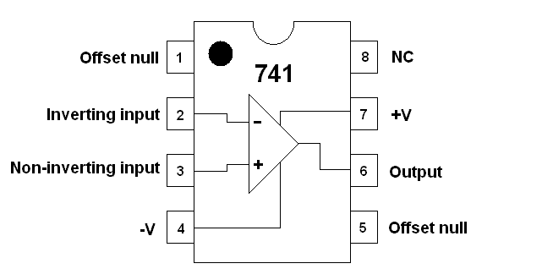
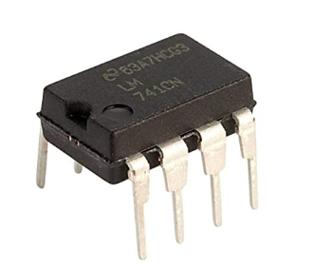
Pin Diagram and IC 741

Slide 4
PIN Description
Pin1 – Offset Null
Pin2 – Inverting Input
Pin3 – Non Inverting Input
Pin4 – -Vcc
Pin5 – Offset Null
Pin6 – Output Voltage
Pin7 – +Vcc
Pin8 – NC

Slide 5
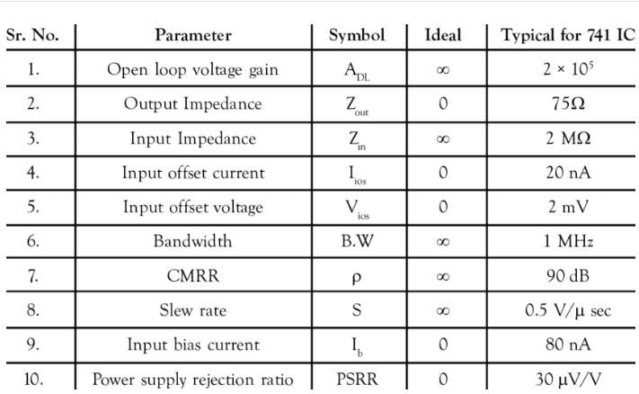
Properties of Op-Amp

Slide 6
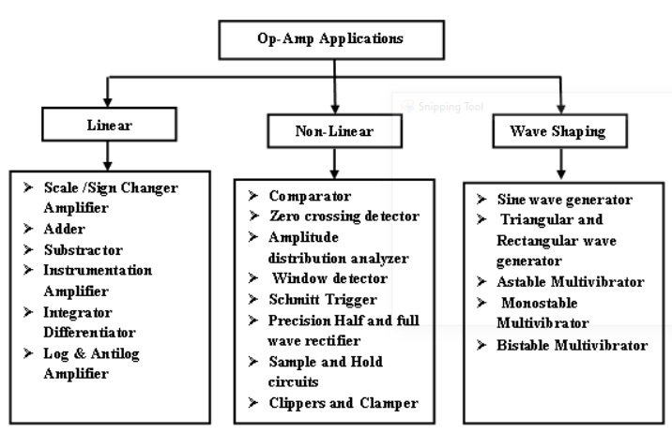

Slide 7
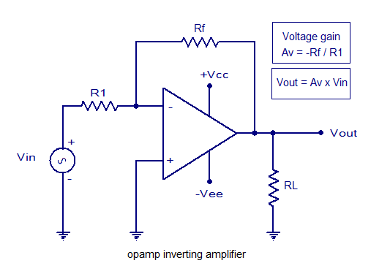
Inverting Amplifier

Slide 8
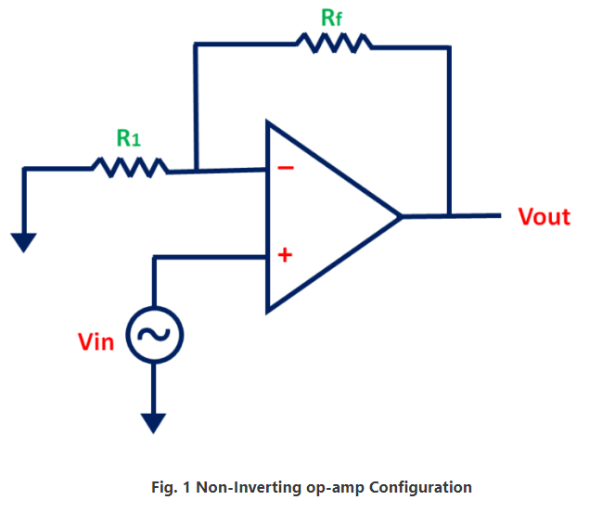
Non Inverting Amplifier

Slide 9
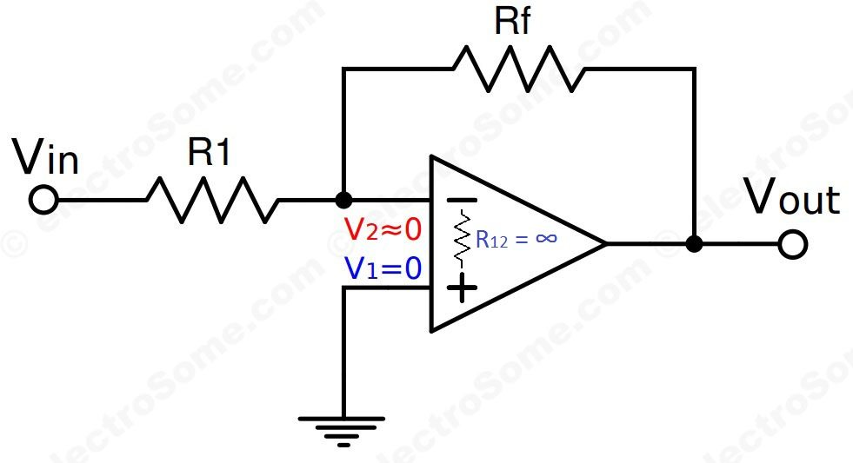
Virtual Ground

Slide 10
